Slide 1
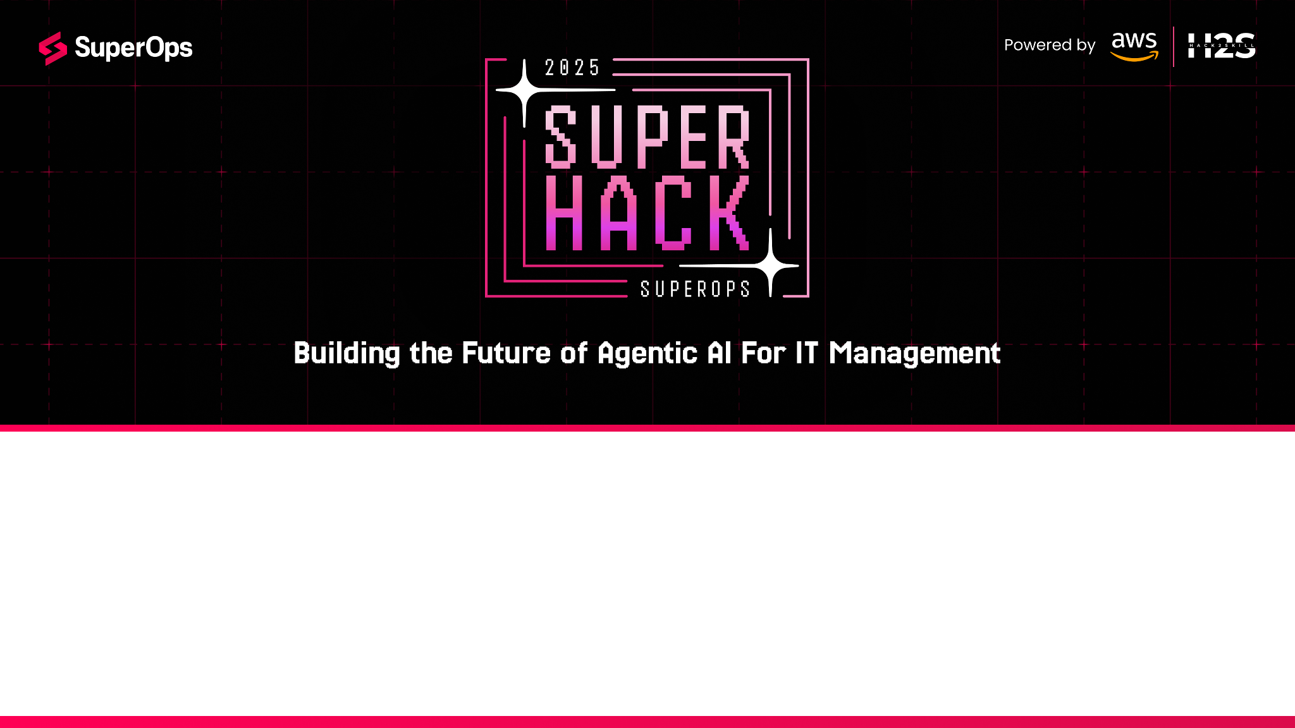
Team Name : Tech wanderers
Team Leader Name : Pavan Y N
Problem Statement : Operational efficiency improvement for MSPs and IT Teams

Slide 2

Brief about the Prototype:
AI-Powered MSP Operations Agent
This intelligent operations assistant automates key IT workflows—alert triage, patch management, and remediation—using a fully AWS-native, serverless architecture. It delivers real-time decisions and measurable efficiency improvements across your managed service operations.
What It Solves :
Simplifies alert management: Converts noisy, repetitive alerts into clear, prioritized action lists that reflect real business impact—cutting alert fatigue and improving response time.
Streamlines patching: Analyzes scattered patch data and automatically creates an AI-driven deployment plan that includes risk assessment, maintenance windows, and rollback options.
Accelerates remediation: Generates production-ready remediation scripts on demand, ensuring faster, safer issue resolution with full auditability and traceability.

Slide 3
Opportunity should be able to explain the following:
How does it make difference :
Built as a real AWS native, serverless agent using Bedrock (qwen), Lambda, and API Gateway deployable, scalable, and production-ready from day one.
Goes beyond chatbots with structured JSON outputs for triage, patching, and remediation no manual cleanup or guesswork.
Delivers safe, auditable PowerShell fixes with rollback and validation for faster, reliable remediation.
Comes with live dashboards and logs in CloudWatch and DynamoDB to prove real results and compliance.
How does It Solve It :
Alert fatigue: Groups and ranks alerts by business impact, saving triage time.
Patch chaos: Creates AI-driven patch plans with risks, windows, and rollbacks.
Slow fixes: Auto-builds tested scripts for quick, safe remediation.
Proof: Live metrics show uptime, speed, and efficiency gains.
Why It Stands Out :
A production-first, low-cost AWS agent with measurable outcomes not just AI talk, but working, verifiable automation.

Slide 4
List of features offered by the solution
Intelligent Alert Triage & Prioritization
AI-Powered Patch Risk Assessment
Real-Time Web Dashboard
Automated Administrative Task Orchestration
REST API for Universal Integration

Slide 5
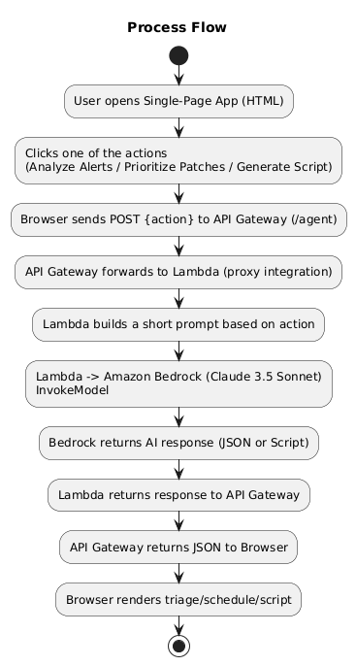
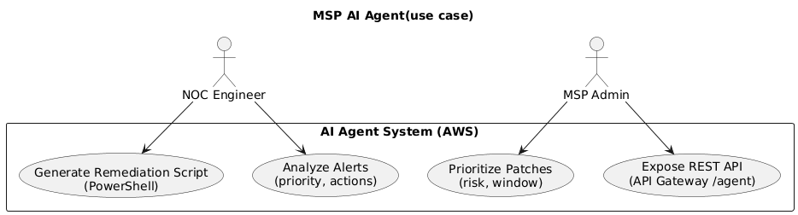

Slide 6
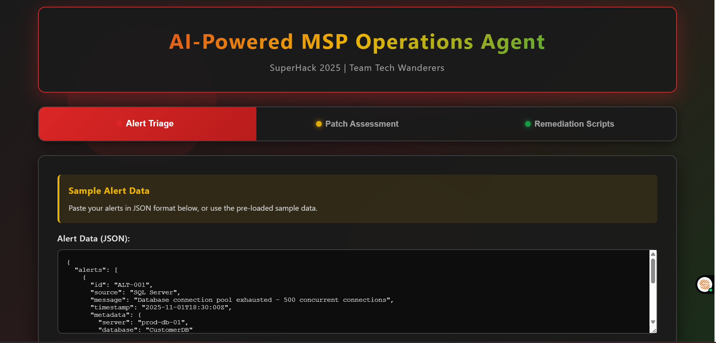
Wireframes/Mock diagrams of the proposed solution

Slide 7
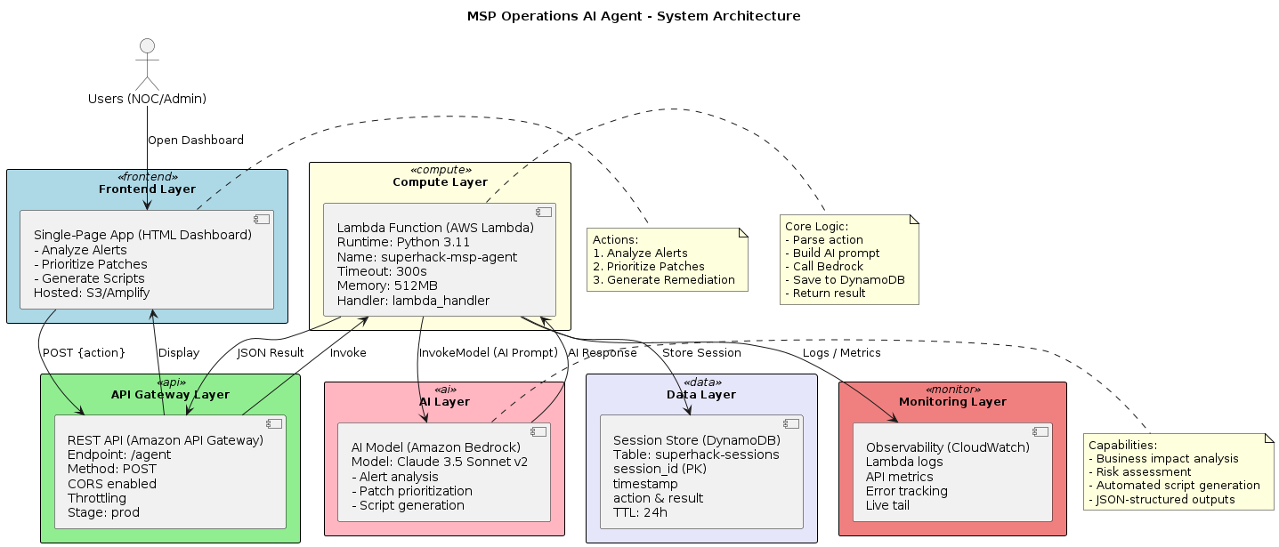

Slide 8
Technologies to be used in the solution:
Core Stack: AWS Lambda (Python) for serverless logic, Amazon Bedrock (Qwen 3 32b) for AI reasoning, API Gateway for REST access, DynamoDB for session storage, CloudWatch for logs & metrics, S3 for hosting the web dashboard, IAM for access control.
Tech: Python 3.11+, Javascript, HTML5, CSS3.
AI Layer: Qwen 3 via Bedrock handles alert triage, patch planning, and PowerShell generation using structured JSON prompts.
Tools: AWS CLI, boto3 SDK, Git/GitHub, cURL for testing.

Slide 9
Estimated implementation cost (optional):

Slide 10
Snapshots of the prototype

Slide 11
Prototype Performance report/Benchmarking :

Slide 12
Additional Details/Future Development (if any)
As of now everything is in json format, the output and input. So in future integrating the solution with relevant applications is to be done.

Slide 13
GitHub & Demo URL
http://msp-agent-dashboard-pavan.s3-website-us-east-1.amazonaws.com/

Slide 14
Add as per the requirements for the hackathon:

Slide 15
